Slide 1

Exploratory Data Analysis on Facebook Data Set
INSAID: GCD: Term-2 Project by S.R.Uthayanan

Slide 2
Agenda
Problem Statement
Description of Dataset
Data Profiling
Exploratory Data Analysis & Conclusions

Slide 3
Problem Statement
We are trying to study the dataset provided to identify certain patterns with respect to how the users are making use of this most popular social networking app depending on their age group, gender etc.

Slide 4
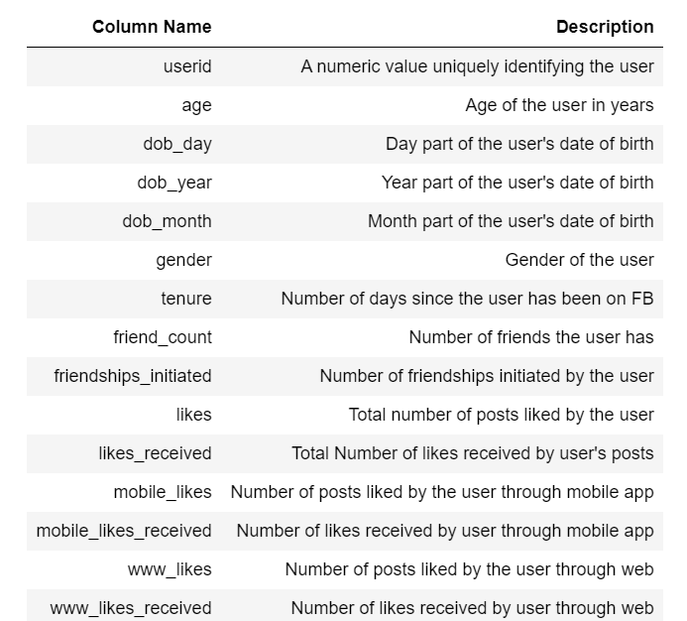
Description of Dataset
The dataset comprises of 99003 observations of 15 columns

Slide 5
Data Profiling
Understanding the Dataset
Dataset info:
Number of variables:15
Number of observations: 99003
Missing cells: <0.1%
Variables types:
Numeric = 14
Categorical = 1
Dataset has 175 (0.2%) Missing Value in gender column and 2 in tenure column

Slide 6
Exploratory Data Analysis with Conclusions

Slide 7
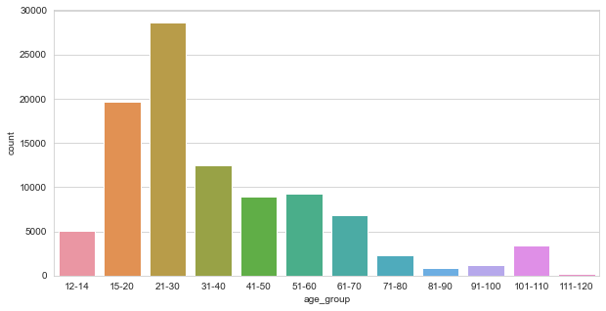
Distribution of users Age
Maximum users of Facebook are of Age 15 to 30 years

Slide 8
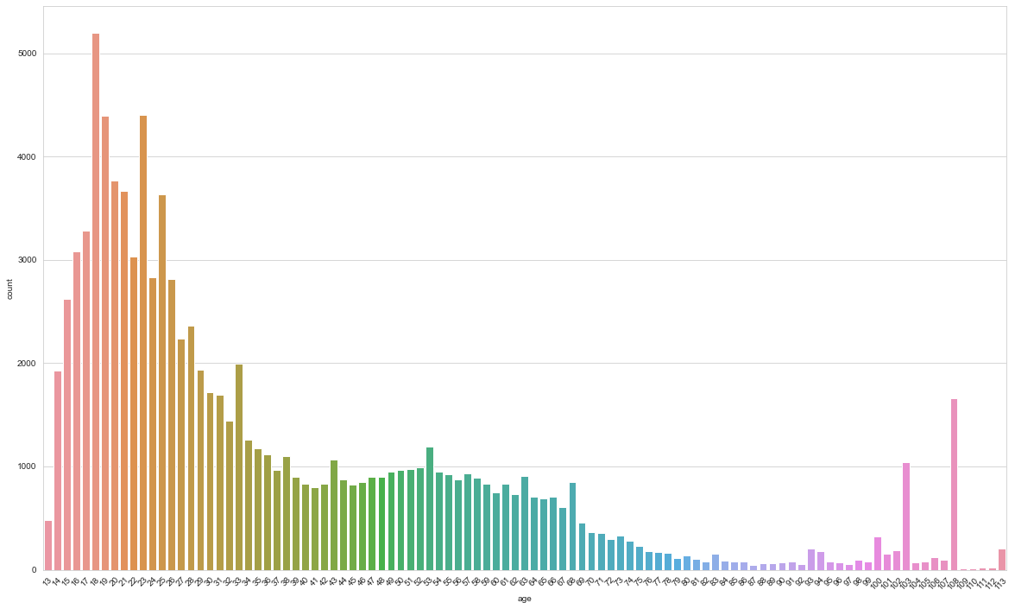
Distribution of users Age
From above graph it shows 103 ,108 and 113 age group, user count is higher compare to other years, might be user is providing incorrect detail by not specifying their correct year of birth.

Slide 9
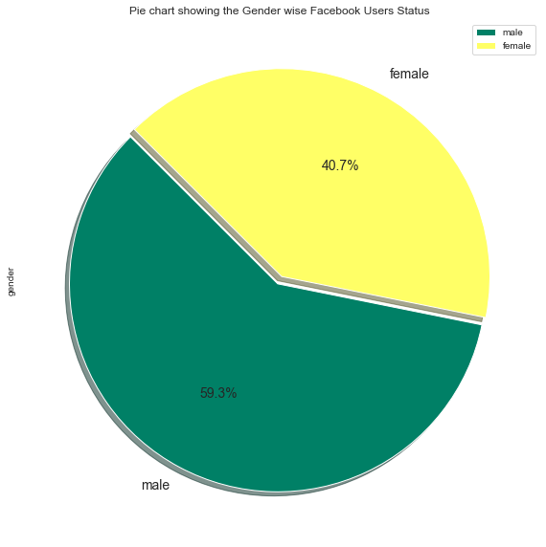
Gender wise Analysis
Maximum users of Facebook are Males about 59.3%
(18% more than Females)

Slide 10
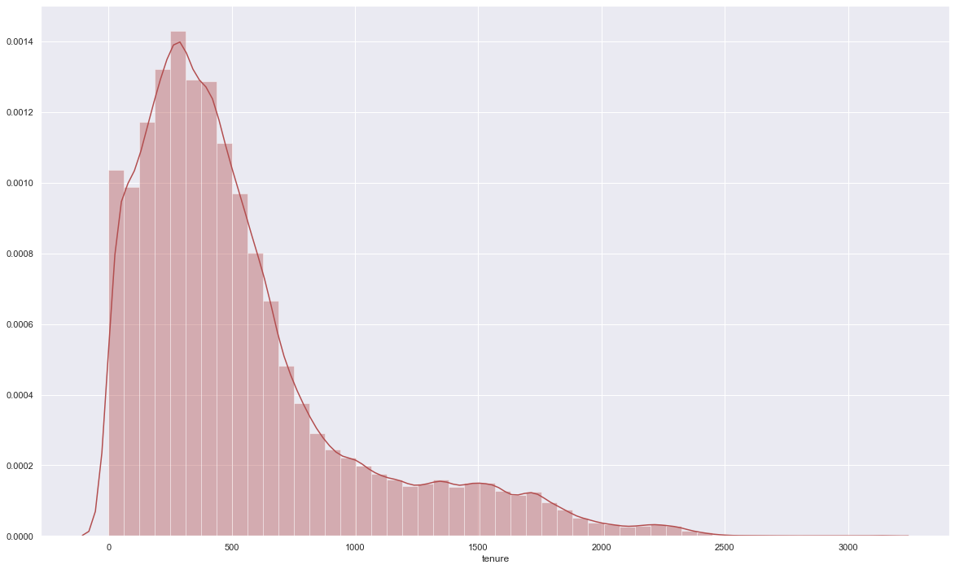
Analysis based on Tenure
from the above plot we can infer that more number of User have joined from Last 2 Years of data collection

Slide 11
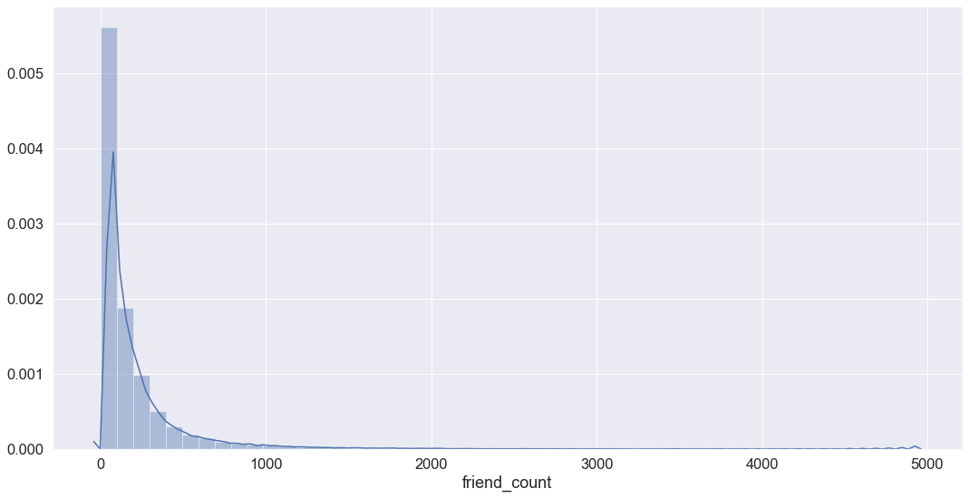
Friend Count Distribution
More number of users have fewer than 500 Facebook Friends
2% of users did not have any friends

Slide 12
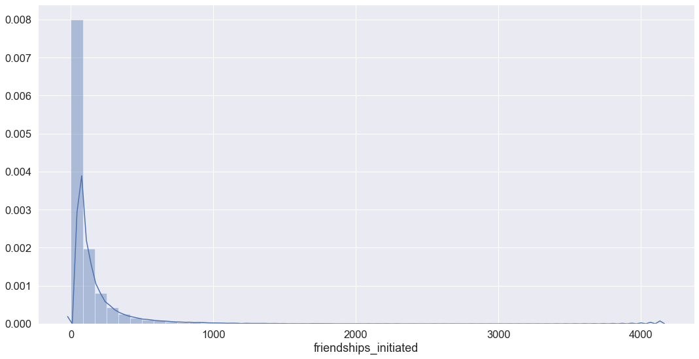
Distribution of Friendships Initiated
3% of users were not initiated even a single friends

Slide 13
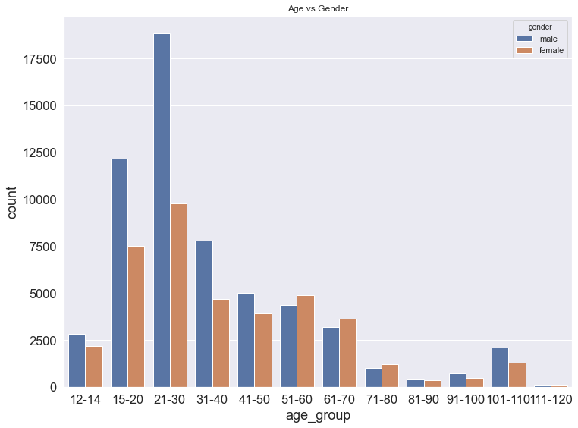
Comparing Gender wise users in Age Group
across all age group male users are more, except age group 51 to 80 where female users are more.

Slide 14
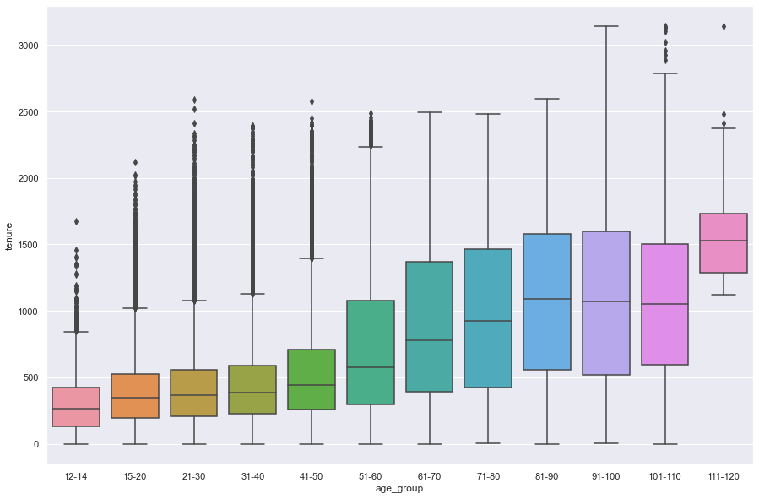
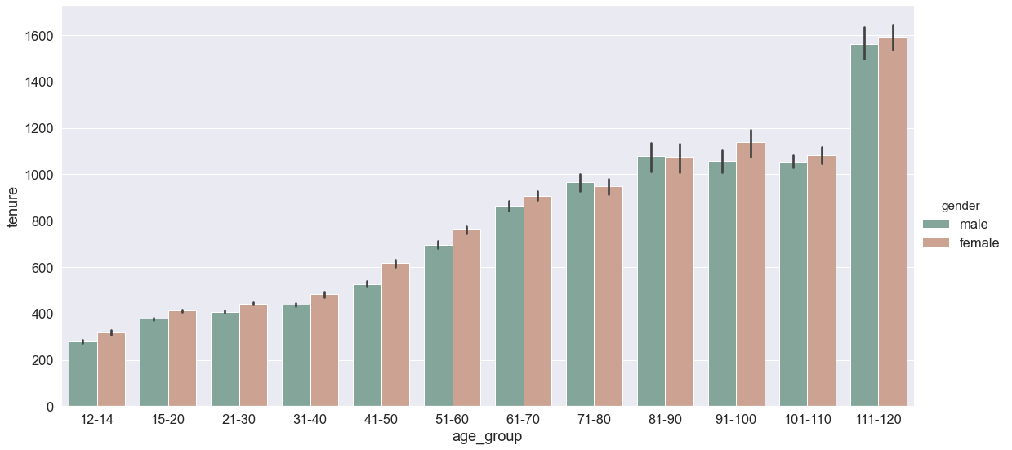
Age vs Tenure
Facebook was launched on 4th of February 2004 since then users are using Facebook
Maximum tenure as per the dataset is around 9 years
From this we can confirm this dataset is created in 2013.
Across all age group Female has tenure slightly higher than the Males.

Slide 15
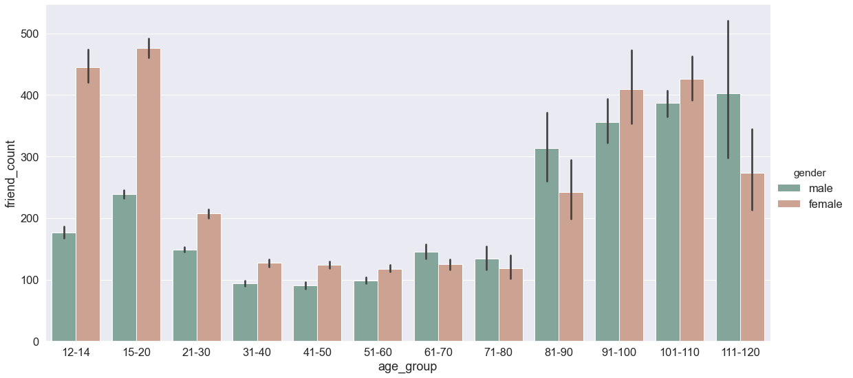
Comparing Age vs Friend Count
People with an age of less than 30 and more than 80 have more friends than the middle aged people.
Females with an age of less than 30 have more friends than the Males

Slide 16
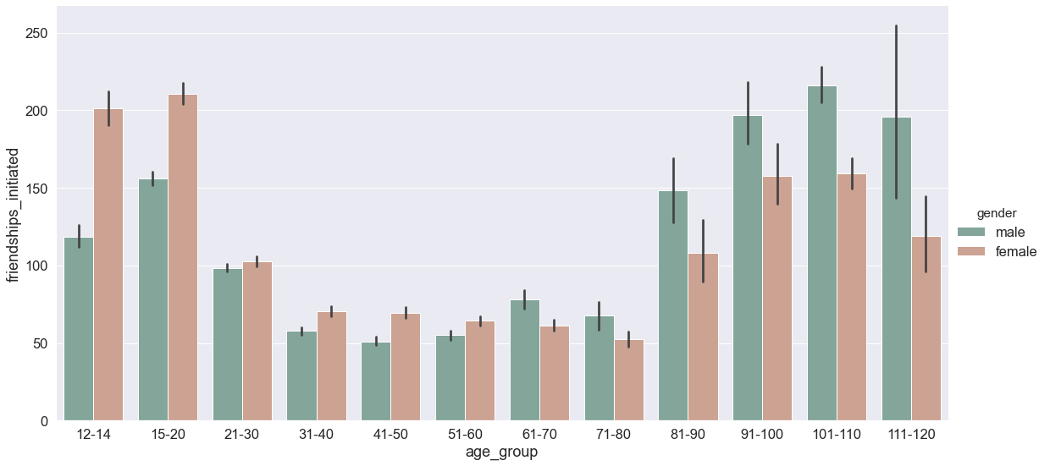
How Friendships Initiated is Related to Age and Gender
Up to 60 years of age, Female Users were initiated more friends.
Above 60 year of age, Male Users were initiated more friends.

Slide 17
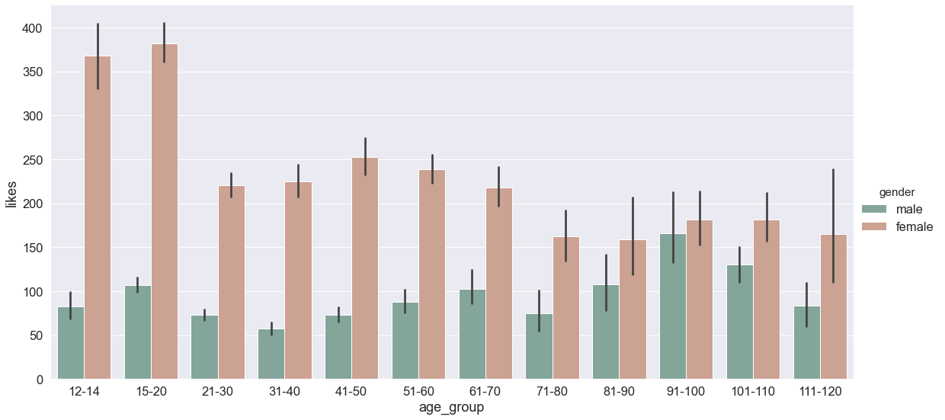
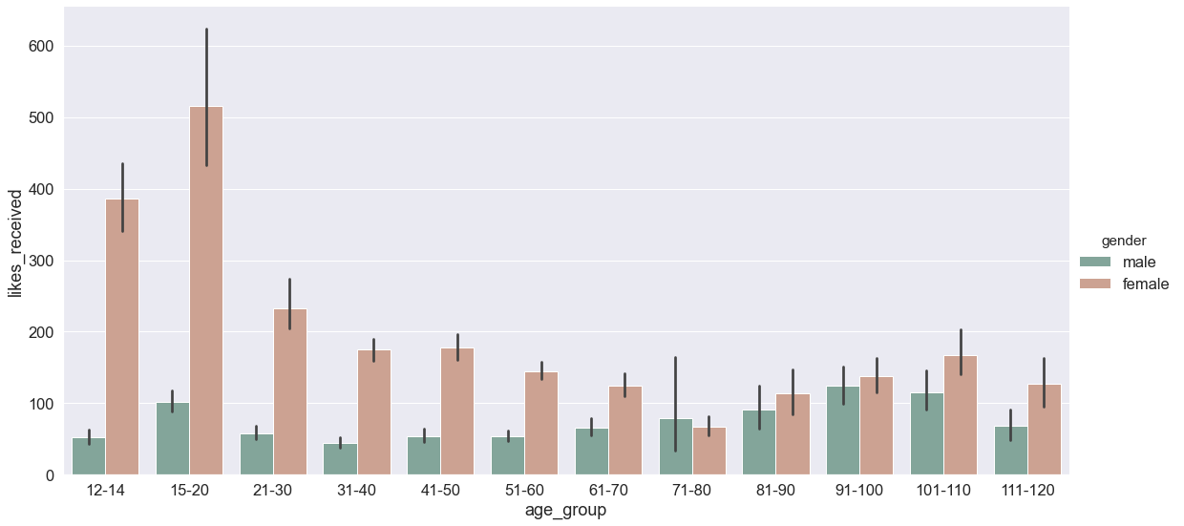
How does Gender and Age group Related to Likes
Across the age group more Females are liked the Posts than the Males
Age group 13 to 20 are more active in liking the Post
The above pattern is also reflecting the same in Likes Received

Slide 18
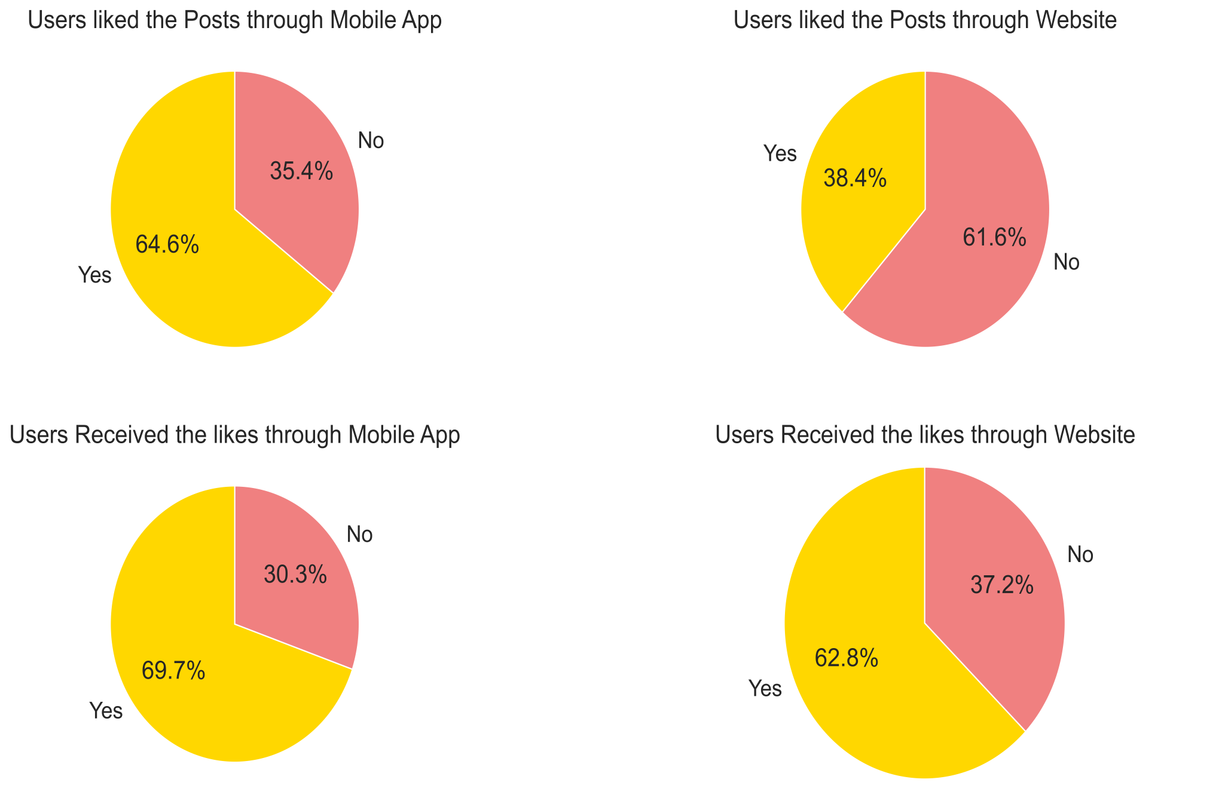
How users are using the Facebook through Website and Mobile App

Slide 19
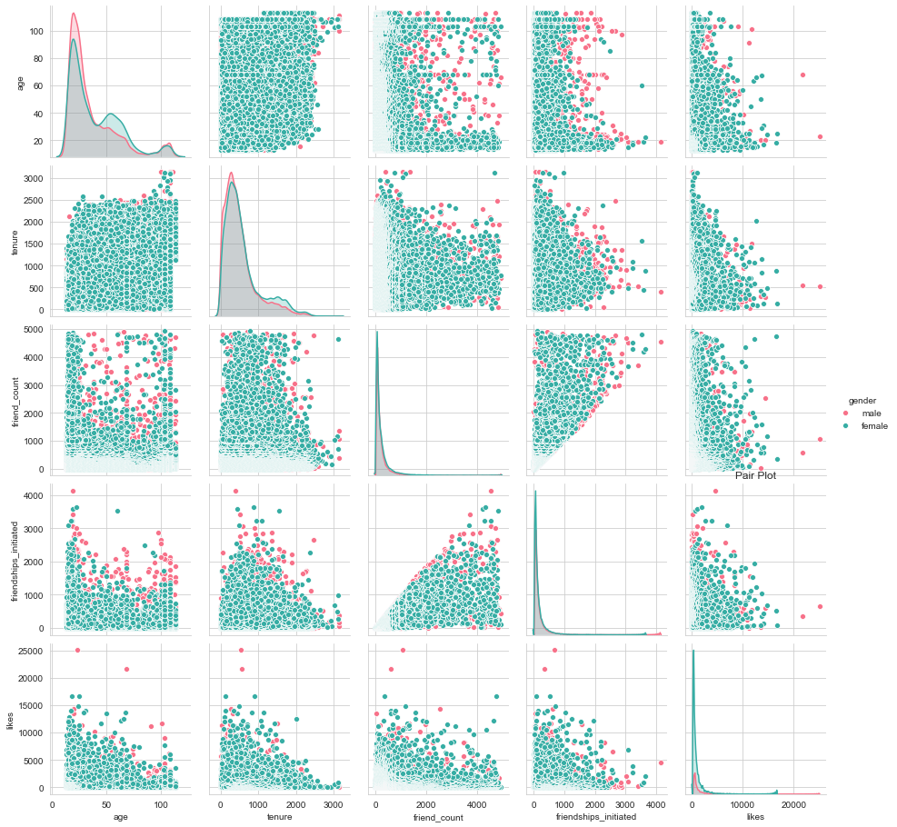
Pair Plot

Slide 20
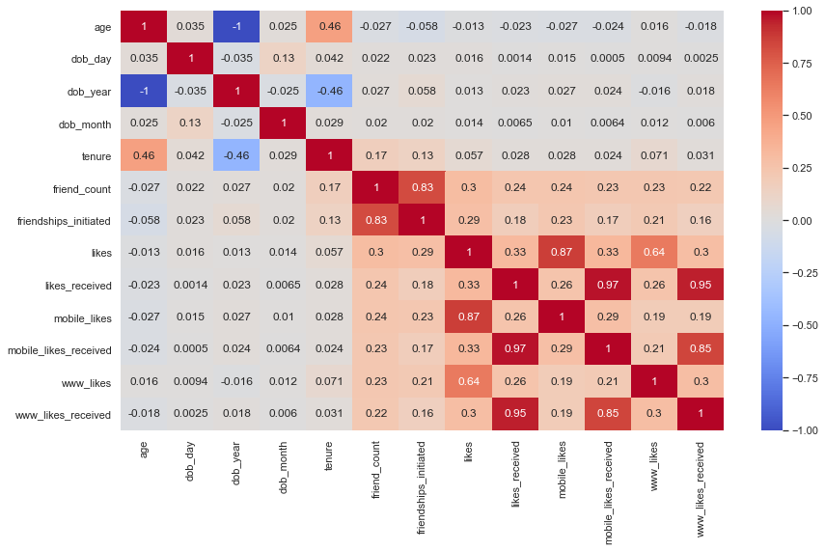
Correlation of Features
Friend Count and Friendships Initiated have strong Correlations, as friendships Initiated increases, the Friend Count tends to increase

Slide 21

Thank You

